Slide 1


2024 HCA Single-Cell Omics in-person Computational and Experimental Design Workshop Single-cell data differential abundance testing
June 24-28, 2024
Bangkok, Thailand

Slide 2
Computational track schedule
 | Beginner | Advanced
Monday | Preprocessing/QC | Data integration/cell type annotation/DE
Tuesday | Clustering/DE/data integration/cell type annotation | multi-omics/DA
Wednesday | TCR/BCR/CITE-Seq
Thursday | Trajectory inference/cell-cell communication
Friday | project/presentation

Slide 3
Today’s Outline
Motivation
Computational approaches to differential abundance (DA) testing
Examples

Slide 4
When do we use differential abundance analysis?
Identify cellular correlates of particular clinical or experimental outcomes
identify subgroups of cells whose abundances change significantly in response to disease progression or perturbation

Slide 5
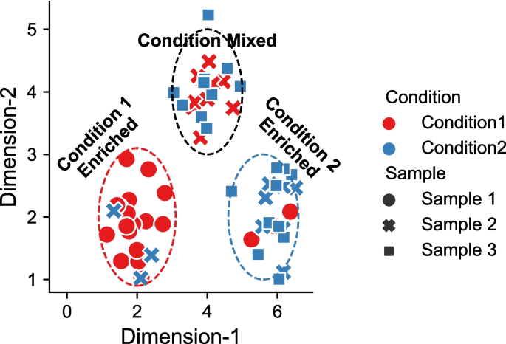
Differential abundance testing illustration
Plotkin et al. (2024) Genome Biology Genome Biol 25, 9 (2024). https://doi.org/10.1186/s13059-023-03143-0
Notes:
experimental conditions. Cells from condition 1 are enriched in lower left region (red circle), while cells from condition 2 is enriched in lower right region (blue circle). The upper region (black circle) is equally mixed with cells from both the condition 1 and 2 without DA effects

Slide 6
Differential abundance testing tool categories
Clustering-based methods:
Dependent on having appropriately binned cells into phenotypically coherent cell populations
Limitations in identifying novel, and functionally distinct cellular subsets
E.g., Cydar (2017), Diffcyt (2019)
Clustering-free
Infer condition-specific per-cell importances
A more granular approach for identifying outcome-associated cells
E.g., Meld (2021), CNA(2022), Milo (2022), etc.
Notes:
In addition to RNA, we can profile many other cellular molecules. DNA- genome, epigenome- chromatin accessibility, methylation. Protein- mass cytometry. One particularly important advance is being able to make multiple different measurements on a single cell. Establish causality between RNA + protein or epigenome + RNA.

Slide 7
Differential abundance testing tool categories
Clustering-based methods:
Dependent on having appropriately binned cells into phenotypically coherent cell populations
Limitations in identifying novel, and functionally distinct cellular subsets
E.g., Cydar (2017), Diffcyt (2019)
Clustering-free
Infer condition-specific per-cell importances
A more granular approach for identifying outcome-associated cells
E.g., MELD (2021), CNA(2022), Milo (2022), etc.
Notes:
In addition to RNA, we can profile many other cellular molecules. DNA- genome, epigenome- chromatin accessibility, methylation. Protein- mass cytometry. One particularly important advance is being able to make multiple different measurements on a single cell. Establish causality between RNA + protein or epigenome + RNA.

Slide 8
DA testing examples
Cydar
CNA
Milo
Notes:
Sergio

Slide 9
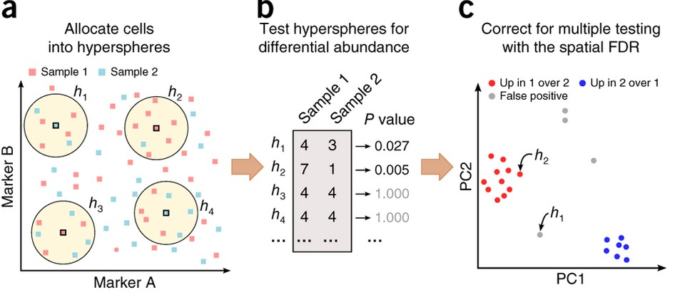
Mass cytometry inspired DA method: Cydar
Mass cytometry is also high dimensional data!
each hypersphere is centered on an existing cell and has radius r = 0.5√M. Can be overlapping
count the number of cells from each sample assigned to each hypersphere
Testing is performed with negative binomial generalized linear models (NB GLMs),
accounts for the discrete nature of counts and model overdispersion
Weighted version of BH correction based on volume of hyperspheres
Notes:
Mass cytometry can assay more markers than conventional flow cytometry, which increases the dimensionality of the data. Existing approaches cannot directly address the important question of what differs between biological conditions in multicondition experiments.
To this end, one strategy is to identify subpopulations that change in abundance between conditions^{9,10}. For example, certain immune compartments are enriched or depleted upon drug treatment, and the composition of cell types changes during development. Detection of these differentially abundant (DA) subpopulations is useful, as it can provide insights into the cause or effect of the biological differences between conditions.
Testing is performed with negative binomial generalized linear models (NB GLMs), which explicitly account for the discrete nature of counts and model overdispersion
the spatial FDR can be interpreted as the proportion of the total volume of DA hyperspheres (the union rather than sum of the individual volumes, due to overlaps between hyperspheres) that is occupied by false-positive hyperspheres.

Slide 10
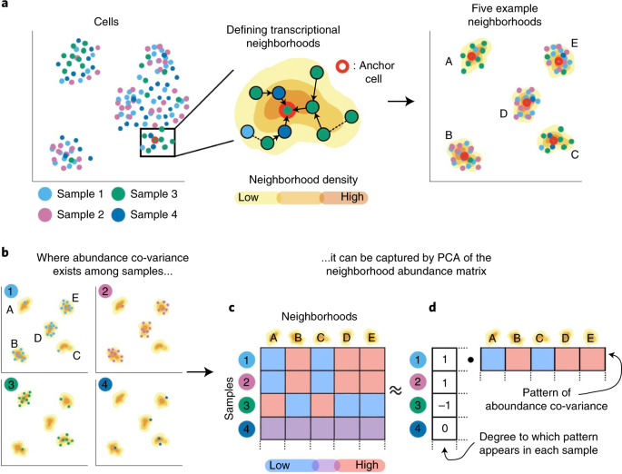
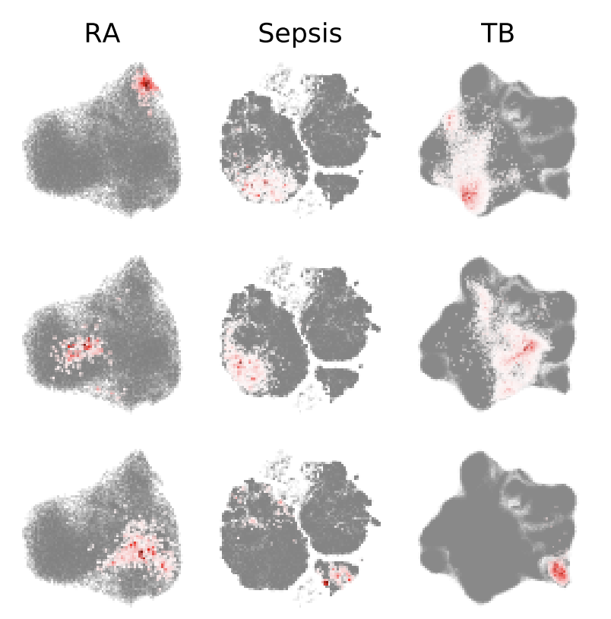
Co-varying neighborhood analysis (CNA)
cell–cell similarity graph based on low dimensional embedding
CNA defines one transcriptional neighborhood per cell in the dataset.
Each other cell belongs to this neighborhood according to the probability that a random walk from that cell will arrive at the neighborhood’s anchor cell after a certain number of steps.
Notes:
CNA performs statistical testing for associations between any sample-level attribute and the abundances of these co-varying neighborhood groups. Hyperspheres→ neighborhoods in graph
every other cell m′ belongs to the neighborhood anchored at cell m according to the probability that a random walk in the graph from m′ will arrive at m after s steps (Methods and Fig. 1a). CNA chooses s in a data-dependent manner to minimize neighborhood size while ensuring that neighborhoods are not dominated by cells from only a few samples.

Slide 11
Co-varying neighborhood analysis (CNA)
Neighborhood abundance matrix (NAM) whose n,m-th entry is the relative abundance of cells from sample n in neighborhood m
Run PCA on the NAM to define neighborhood groups whose abundances change in concert across sample
NAM principal component (NAM-PCs)
Test for association between an attribute (e.g. clinical, experimental) and patterns: Model the attribute value for each sample as a linear function of the sample’s loadings on the first k NAM-PCs
Define the specific cell populations driving any detected associations: use neighborhood loadings on the first k NAM-PCs and estimated per-PC effect sizes from our linear model
Notes:
CNA performs statistical testing for associations between any sample-level attribute and the abundances of these co-varying neighborhood groups.
every other cell m′ belongs to the neighborhood anchored at cell m according to the probability that a random walk in the graph from m′ will arrive at m after s steps (Methods and Fig. 1a). CNA chooses s in a data-dependent manner to minimize neighborhood size while ensuring that neighborhoods are not dominated by cells from only a few samples.

Slide 12
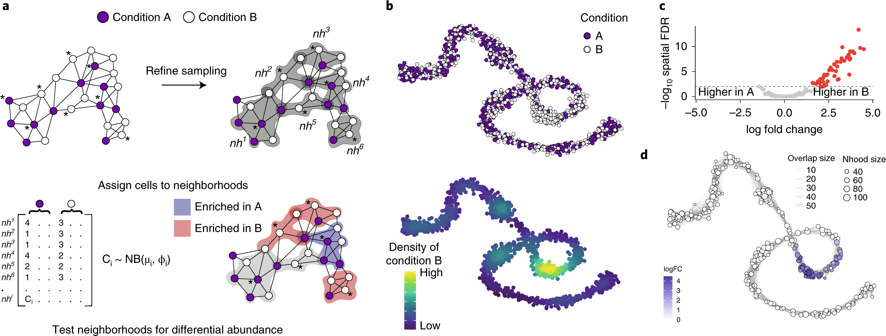
Milo: Differential abundance testing on single-cell data using k-nearest neighbor graphs
Construct k-nearest neighbor (k-NN) Graph: Build a k-NN graph to represent cell-cell similarities.
Define Neighborhoods: Assign cells to partially overlapping neighborhoods within this graph
Differential Testing: Perform differential abundance testing on these neighborhoods to identify differentially abundant cell states while controlling the FDR across the graph neighborhoods.
Dann, E., Henderson, N.C., Teichmann, S.A. et al. Nat Biotechnol 40, 245–253 (2022). https://doi.org/10.1038/s41587-021-01033-z
Notes:
a, Schematic of the Milo workflow. Neighborhoods are defined on index cells, selected using a graph sampling algorithm. Cells are quantified according to the experimental design to generate a counts table. Per-neighborhood cell counts are modelled using a negative binomial GLM, and hypothesis testing is performed to determine differentially abundant neighborhoods.
allows overlapping neighboring regions, which alleviates the principal pitfalls of using discrete clusters for differential abundance testing.
KNN is a common scaffold for single cell anlaysis

Slide 13
Milo: Differential abundance testing on single-cell data using k-nearest neighbor graphs
Define Neighborhoods:
A neighborhood is defined as the group of cells that are connected to an index cell by an edge in the graph.
Sample for index cells:
initial sparse sampling→ a set of single cells
Determine KNN neighborhoods for them
Calculate medium of KNNs
The nearest cell to these medium positions are the final indices
Dann, E., Henderson, N.C., Teichmann, S.A. et al. Nat Biotechnol 40, 245–253 (2022). https://doi.org/10.1038/s41587-021-01033-z
Notes:
This procedure has three main advantages: (1) fewer, yet more representative, neighborhoods are selected, as initial random samplings from dense regions of the KNN graph will often converge to the same index cell (Supplementary Fig. 1a); (2) the representative neighborhoods include more cells on average (Supplementary Fig. 1b); and (3) neighborhood selection is more robust across initializations (Supplementary Fig. 1c).

Slide 14
Milo: Differential abundance testing on single-cell data using k-nearest neighbor graphs
Differential Testing:
count the numbers of cells present in each neighborhood per experimental sample
Use a negative binomial (NB) GLM framework, normalizing for differences in cell numbers across samples
quasi-likelihood (QL) F-statistic for comparing different hypotheses
Spatial FDR: weighted FDR procedure that accounts for the spatial overlap of neighborhoods
weight each hypothesis test P value by the reciprocal of the kth nearest neighbor distance.)
Dann, E., Henderson, N.C., Teichmann, S.A. et al. Nat Biotechnol 40, 245–253 (2022). https://doi.org/10.1038/s41587-021-01033-z
Notes:
a, Schematic of the Milo workflow. Neighborhoods are defined on index cells, selected using a graph sampling algorithm. Cells are quantified according to the experimental design to generate a counts table. Per-neighborhood cell counts are modelled using a negative binomial GLM, and hypothesis testing is performed to determine differentially abundant neighborhoods.
allows overlapping neighboring regions, which alleviates the principal pitfalls of using discrete clusters for differential abundance testing.
KNN is a common scaffold for single cell anlaysis

Slide 15
Example using Milo on simulated dataset
Dann, E., Henderson, N.C., Teichmann, S.A. et al. Nat Biotechnol 40, 245–253 (2022). https://doi.org/10.1038/s41587-021-01033-z
Notes:
b, A force-directed layout of a KNN graph representing a simulated continuous trajectory of cells sampled from two experimental conditions (top panel: condition A, purple; condition B, white; bottom panel: kernel density of cells in condition B).

Slide 16
Example using Milo on simulated dataset
Dann, E., Henderson, N.C., Teichmann, S.A. et al. Nat Biotechnol 40, 245–253 (2022). https://doi.org/10.1038/s41587-021-01033-z
Notes:
a, Schematic of the Milo workflow. Neighborhoods are defined on index cells, selected using a graph sampling algorithm. Cells are quantified according to the experimental design to generate a counts table. Per-neighborhood cell counts are modelled using a negative binomial GLM, and hypothesis testing is performed to determine differentially abundant neighborhoods. b, A force-directed layout of a KNN graph representing a simulated continuous trajectory of cells sampled from two experimental conditions (top panel: condition A, purple; condition B, white; bottom panel: kernel density of cells in condition B). c, Hypothesis testing using Milo accurately and specifically detects differentially abundant neighborhoods (FDR 1%). Red points denote differentially abundant neighborhoods. d, A graph representation of the results from Milo differential abundance testing. Nodes are neighborhoods, colored by their log fold change. Non-differentially abundant neighborhoods (FDR 1%) are colored white, and sizes correspond to the number of cells in a neighborhood. Graph edges depict the number of cells shared between adjacent neighborhoods. The layout of nodes is determined by the position of the neighborhood index cell in the force-directed embedding of single cells. Nhood, neighborhood.

Slide 17
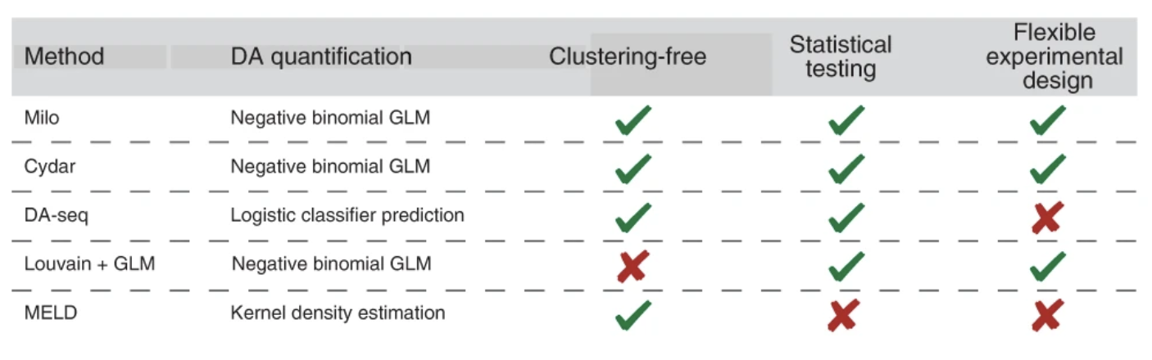
Compare Milo against some other methods
Dann, E., Henderson, N.C., Teichmann, S.A. et al. Nat Biotechnol 40, 245–253 (2022). https://doi.org/10.1038/s41587-021-01033-z
Notes:
we compared the results to two alternative methods for clustering-free differential abundance analysis (Fig. 2b and Supplementary Table 2): Cydar, originally designed to model differential abundance in mass cytometry data⁶, and DA-seq⁷, which uses the structure of single-cell KNN graphs to identify differential abundance regions. In addition, we applied the current standard-of-practice differential abundance analysis for single-cell experiments: graph clustering followed by differential abundance testing among conditions within clusters.

Slide 18
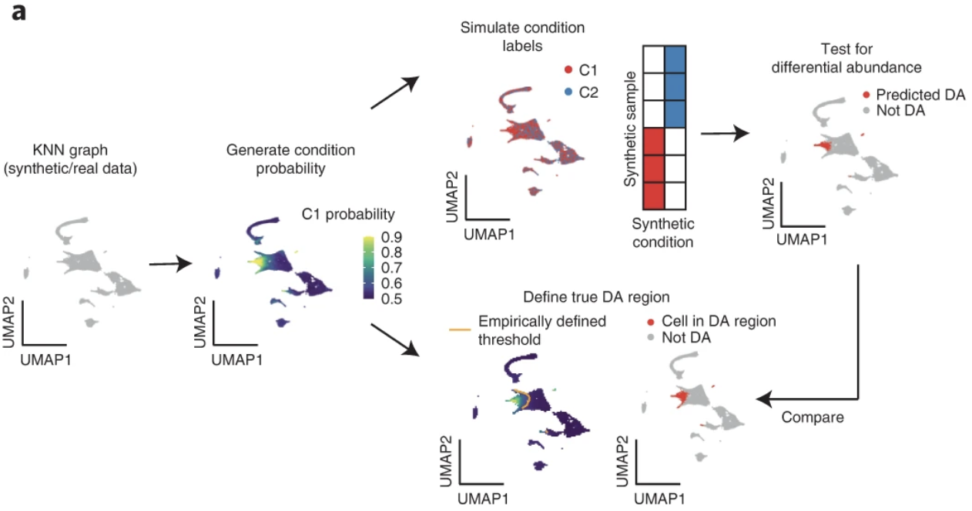
Benchmark using simulated dataset
A smooth probability for each single-cell to be in condition 1 is used to assign condition labels to cells (cells from each condition are split into three replicates)
Dann, E., Henderson, N.C., Teichmann, S.A. et al. Nat Biotechnol 40, 245–253 (2022). https://doi.org/10.1038/s41587-021-01033-z
Notes:
Example based on a single-cell atlas of mouse gastrulation
a smooth probability for each single-cell to be in condition 1 (P(C1)), that is used to assign condition labels to cells
Cells from each condition are then assigned to one of three simulated replicates, thus mimicking a balanced experimental design with a minimal number of replicates required to estimate a variance parameter

Slide 19
Benchmark using simulated dataset
A smooth probability for each single-cell to be in condition 1 is used to assign condition labels to cells
Differential abundance testing methods are run counting the cells in each synthetic condition.
Dann, E., Henderson, N.C., Teichmann, S.A. et al. Nat Biotechnol 40, 245–253 (2022). https://doi.org/10.1038/s41587-021-01033-z
Notes:
a smooth probability for each single-cell to be in condition 1 (P(C1)), that is used to assign condition labels to cells

Slide 20
Benchmark using simulated dataset
A smooth probability for each single-cell to be in condition 1 is used to assign condition labels to cells
Differential abundance testing methods are run counting the cells in each synthetic condition.
The cells assigned to a predicted differential abundance region are compared to a ground truth differential abundance region
Dann, E., Henderson, N.C., Teichmann, S.A. et al. Nat Biotechnol 40, 245–253 (2022). https://doi.org/10.1038/s41587-021-01033-z
Notes:
defined by cells over an empirically determined threshold for each dataset topology. cells with P(C1) > 75th percentile across all cells and simulations for a given topology are assigned to a differentially abundant region

Slide 21
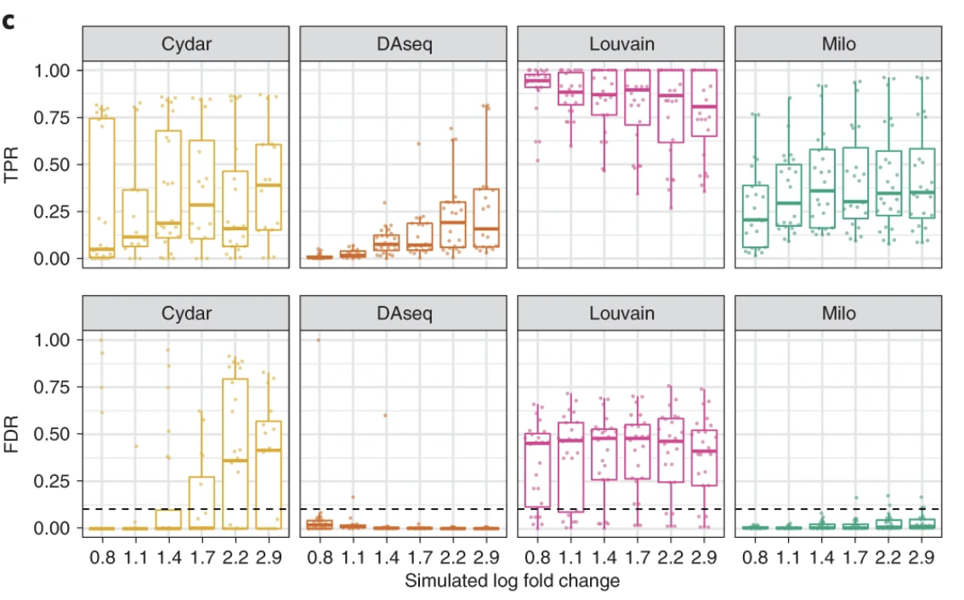
TPR: true positive rate
FDR: false discovery rate
Simulated a total of three datasets
Dann, E., Henderson, N.C., Teichmann, S.A. et al. Nat Biotechnol 40, 245–253 (2022). https://doi.org/10.1038/s41587-021-01033-z
Notes:
We created three simulated datasets, to which we applied the above condition labeling: three discrete clusters (2,700 cells; Extended Data Fig. 1a), a linear trajectory (7,500 cells; Extended Data Fig. 1b) and a branching trajectory (7,500 cells; Extended Data Fig. 1c). Also we simulated differential abundance labels on a real dataset based on a single-cell atlas of mouse gastrulation
- For each dataset, we simulated labels varying the location of the differential abundance population in the graph, as well as the maximum P(C1), thus mimicking different differential abundance fold changes.
Milo detected the simulated differential abundance regions with high sensitivity and maintained FDR control across benchmarking scenarios
Milo outperformed all methods on simulated data generated using the real KNN graph

Slide 22
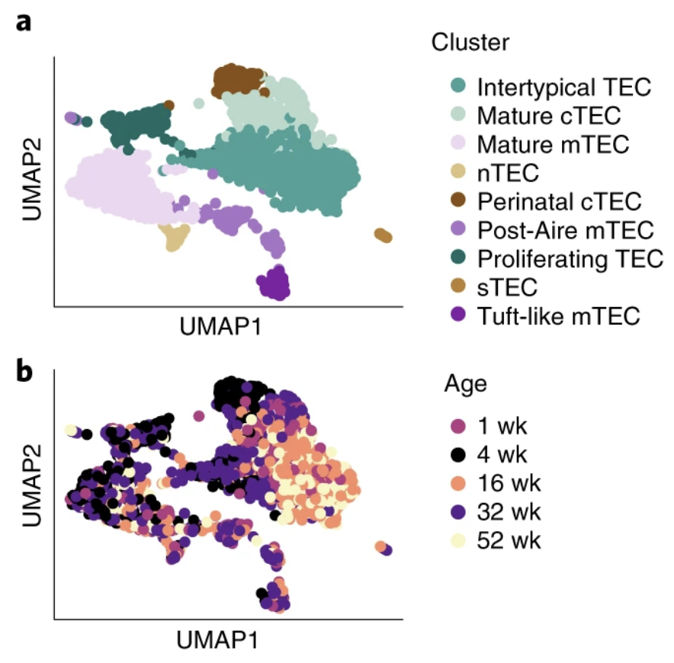
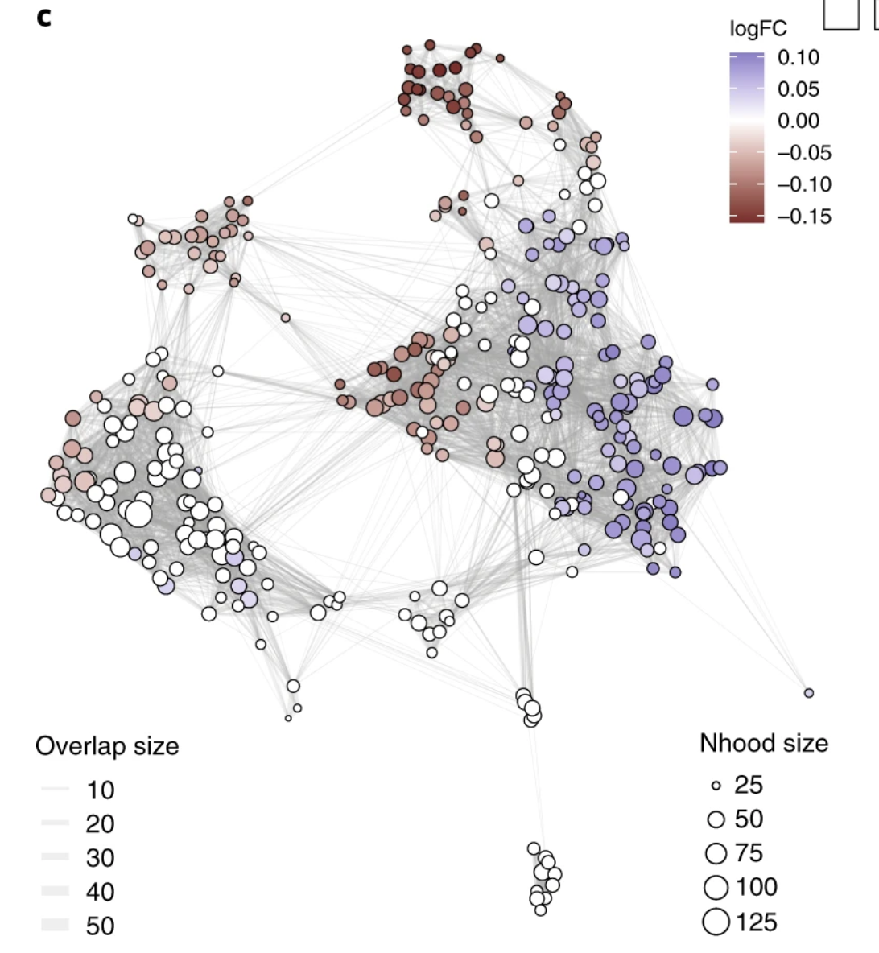
Real world example using Milo
Dann, E., Henderson, N.C., Teichmann, S.A. et al. Nat Biotechnol 40, 245–253 (2022). https://doi.org/10.1038/s41587-021-01033-z
Notes:
mouse thymic epithelial cells (TECs) sampled across the first year of mouse life, which were previously clustered into nine distinct TEC subtypes. Top: annotation, bottom: mouse age
C: neighborhood graph of the results from Milo differential abundance testing. Nodes are neighborhoods, colored by their log fold change across ages. Non-differential abundance neighborhoods (FDR 10%) are colored white, and sizes correspond to the number of cells in each neighborhood. Graph edges depict the number of cells shared between neighborhoods. The layout of nodes is determined by the position of the neighborhood index cell in the UMAP in panel.
- At a 10% FDR, we identified 208 differentially abundant neighbourhoods (101 showed a decreased abundance with age; 107 showed an increased abundance with age)

Slide 23
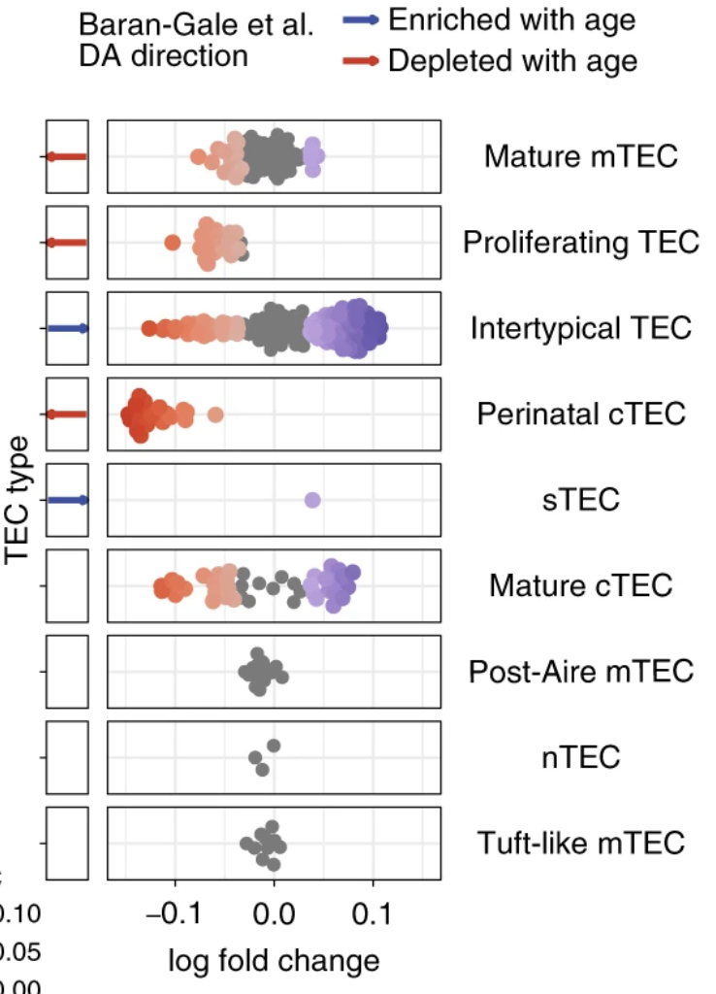
previously identified differentially abundant states
identified an additional subset of these cells that were depleted with age
Recover rare population changes (only 24 cells)
Dann, E., Henderson, N.C., Teichmann, S.A. et al. Nat Biotechnol 40, 245–253 (2022). https://doi.org/10.1038/s41587-021-01033-z
Notes:
They performed marker gene expression identification among the neighborhood groups corresponding to intertypical TECs enriched or depleted in younger mice . This analysis indicated that the cells from younger mice upregulated multiple cytokine response genes (for example, Stat1, Stat4 and Aff3), illustrated by the enriched Gene Ontology term GO:0034097 ‘response to cytokine’ (enrichment adjusted P = 0.047). Cytokine signaling is key to medullary thymic epithelial cell (mTEC) differentiation^{22,23}, indicating that these TECs from younger mice might be differentiating more efficiently to the mTEC lineage.

Slide 24
Recent helpful articles on differential abundance methods
Yi, H., Plotkin, A. & Stanley, N. Benchmarking differential abundance methods for finding condition-specific prototypical cells in multi-sample single-cell datasets. Genome Biol 25, 9 (2024). https://doi.org/10.1186/s13059-023-03143-0
Maity, A.K., Teschendorff, A.E. Cell-attribute aware community detection improves differential abundance testing from single-cell RNA-Seq data. Nat Commun 14, 3244 (2023). https://doi.org/10.1038/s41467-023-39017-z
Reshef, Y.A., Rumker, L., Kang, J.B. et al. Co-varying neighborhood analysis identifies cell populations associated with phenotypes of interest from single-cell transcriptomics. Nat Biotechnol 40, 355–363 (2022). https://doi.org/10.1038/s41587-021-01066-4
Burkhardt, D.B., Stanley, J.S., Tong, A. et al. Quantifying the effect of experimental perturbations at single-cell resolution. Nat Biotechnol 39, 619–629 (2021). https://doi.org/10.1038/s41587-020-00803-5Burkhardt, D.B., Stanley, J.S., Tong, A. et al. Quantifying the effect of experimental perturbations at single-cell resolution. Nat Biotechnol 39, 619–629 (2021). https://doi.org/10.1038/s41587-020-00803-5
Dann, E., Henderson, N.C., Teichmann, S.A. et al. Differential abundance testing on single-cell data using k-nearest neighbor graphs. Nat Biotechnol 40, 245–253 (2022). https://doi.org/10.1038/s41587-021-01033-z

